Slide 1
Heart Health Jeopardy
Heart Disease
Heart Facts
Eating
Exercise
Stress
Q $100
Q $100
Q $100
Q $100
Q $100
Q $200
Q $200
Q $200
Q $200
Q $200
Q $300
Q $300
Q $300
Q $300
Q $300
Q $400
Q $400
Q $400
Q $400
Q $400
Q $500
Q $500
Q $500
Q $500
Q $500
Final Jeopardy

Slide 2
$100 Question from Heart Disease
True or False
Heart disease is the #1 cause of death in the United States.
Jeopardy

Slide 3
$100 Answer from Heart Disease
True
Heart Disease Deaths (647,457 people)
Cancer Deaths (599,108 people)
Accidental Death (169,936 people)
Statistics for U.S. Population in 2017
Jeopardy

Slide 4
$200 Question from Heart Disease
In the United States, someone has a heart attack every ____ seconds.
Jeopardy

Slide 5
$200 Answer from Heart Disease
40 seconds
Jeopardy

Slide 6
$300 Question from Heart Disease
List three factors that increase the chance that a person will have heart disease?
Jeopardy

Slide 7
$300 Answer from Heart Disease
Top 3 factors: high blood pressure;
high blood cholesterol; and smoking
Other factors include: diabetes, overweight, unhealthy diet, and not physically active.
Jeopardy

Slide 8
$400 Question from Heart Disease
What is the most common type of heart disease?
Jeopardy

Slide 9
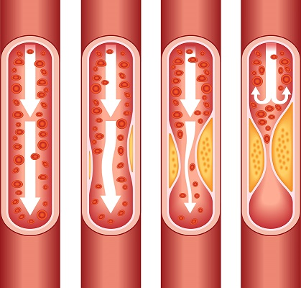
$400 Answer from Heart Disease
Coronary Artery Disease
Coronary artery disease is caused by plaque buildup in the wall of the arteries that supply blood to the heart (called coronary arteries).
Jeopardy

Slide 10
$500 Question from Heart Disease
Some people have symptoms (signs) that they are having a heart attack.
What are TWO signs that a person might be having a heart attack.
Jeopardy

Slide 11
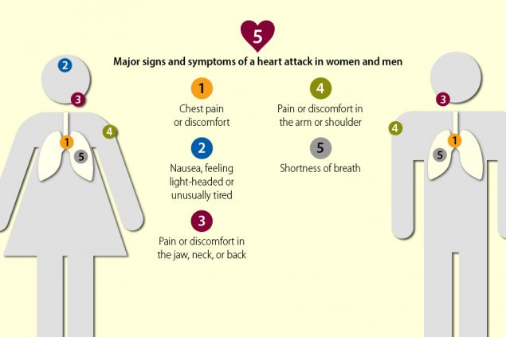
$500 Answer from Heart Disease
Jeopardy

Slide 12
Health Jeopardy
Heart Disease
Heart Facts
Exercise
Stress
Eating
Q $100
Q $100
Q $100
Q $100
Q $100
Q $200
Q $200
Q $200
Q $200
Q $200
Q $300
Q $300
Q $300
Q $300
Q $300
Q $400
Q $400
Q $400
Q $400
Q $400
Q $500
Q $500
Q $500
Q $500
Q $500
Final Jeopardy

Slide 13
$100 Question from Heart Facts
The heart pumps blood from the heart to _______
Jeopardy

Slide 14
$100 Answer from Heart Facts
To EVERY PART of your body including organs, tissues and cells of your body.
Jeopardy

Slide 15
$200 Question from Heart Facts
Each day, the average heart beats_____ times.
1,000
10,000
100,000
1,000,000
Jeopardy

Slide 16
$200 Answer from Heart Facts
Each day, the average heart beats
100,000 TIMES
By the end of a long life, a person’s heart may have beat more than 3.5 billion times.
Jeopardy

Slide 17
$300 Question from Heart Facts
What is the most important thing you can do for a healthy heart?
Jeopardy

Slide 18
$300 Answer from Heart Facts
Exercise Most Days
Jeopardy

Slide 19
$400 Question from Heart Facts
True or False
The more education you have, the lower your risk of heart disease.
Jeopardy

Slide 20
$400 Answer from Heart Facts
TRUE
Where we live and work, our understanding about our bodies, and our access to health care all improve with education.
Jeopardy

Slide 21
$500 Question from Heart Facts
What makes the beating sounds of your heart?
Jeopardy

Slide 22
$500 Answer from Heart Facts
The opening and closing of the heart’s valves.
Jeopardy

Slide 23
Health Jeopardy
Heart
Disease
Heart Facts
Eating
Exercise
Stress
Q $100
Q $100
Q $100
Q $100
Q $100
Q $200
Q $200
Q $200
Q $200
Q $200
Q $300
Q $300
Q $300
Q $300
Q $300
Q $400
Q $400
Q $400
Q $400
Q $400
Q $500
Q $500
Q $500
Q $500
Q $500
Final Jeopardy

Slide 24
$100 Question from Eating
The best way to lose weight is to:
Jeopardy

Slide 25
$100 Answer from Eating
Establish a habit of healthy eating and exercise.
Jeopardy

Slide 26
$200 Question from Eating
It is important to balance what we eat with:
Jeopardy

Slide 27
$200 Answer from Eating
Our level of physical activity
Jeopardy

Slide 28
$300 Question from Eating
What is the Body Mass Index (BMI)?
Jeopardy

Slide 29
$300 Answer from Eating
An estimate of body fat based on measuring a person’s height and weight.
Jeopardy

Slide 30
$400 Question from Eating
Name two things you can do to have a
heart healthy diet.
Jeopardy

Slide 31
$400 Answer from Eating
Eat more fruits and vegetables
Eat beans and legumes
Eat healthy fats
Eat less salt
Eat healthy proteins (lower fat)
Don’t eat too much
Jeopardy

Slide 32
$500 Question from Eating
What free USDA website can give you a
healthy eating plan and help you keep track what you eat?
Jeopardy

Slide 33
$500 Answer from Eating
My Plate
www.choosemyplate.gov
Jeopardy

Slide 34
Health Jeopardy
Heart Disease
Heart Facts
Eating
Exercise
Stress
Q $100
Q $100
Q $100
Q $100
Q $100
Q $200
Q $200
Q $200
Q $200
Q $200
Q $300
Q $300
Q $300
Q $300
Q $300
Q $400
Q $400
Q $400
Q $400
Q $400
Q $500
Q $500
Q $500
Q $500
Q $500
Final Jeopardy

Slide 35
$100 Question from Exercise
True or False
Everyone can benefit from physical activity including people with diseases such as heart disease, diabetes and cancer.
Jeopardy

Slide 36
$100 Answer from Exercise
True
Everyone can benefit from
physical activities.
Jeopardy

Slide 37
$200 Question from Exercise
How many times per week should adults do muscle-strengthening activities?
Jeopardy

Slide 38
$200 Answer from Exercise
Adults should do muscle strengthening or stretching activities at least 2 times per week.
Jeopardy

Slide 39
$300 Question from Exercise
To maintain a healthy weight, it important to balance exercise with _________.
Jeopardy

Slide 40
$300 Answer from Exercise
What we eat (our diet)
Jeopardy

Slide 41
$400 Question from Exercise
Adults should do at least _____ minutes of moderate exercise each week.
30 minutes
60 minutes (1 hour)
120 minutes (2 hours)
150 minutes (2 ½ hours)
180 minutes (3 hours)
Jeopardy

Slide 42
$400 Answer from Exercise
D. 150 minutes (2 ½ hours)
Adults should do at least 2 ½ hours of aerobic exercise each week.
Aerobic exercises make your heart and lungs work harder. This can be walking, riding a bike, gardening, or swimming.
Jeopardy

Slide 43
$500 Question from Exercise
There are many benefits to physical activity. Name three:
Jeopardy

Slide 44
$500 Answer from Exercise
Helps heart and lungs stay healthy (and work better)
Increases strength (muscles)
Maintains healthy bones, muscles, and joints.
Helps deal with stress and anxiety
Improves ability to sleep
Increases energy
Helps you live a longer life
Helps decrease chance of developing most diseases, including cancer, heart disease and diabetes.
Jeopardy

Slide 45
Health Jeopardy
Heart Health
Heart
Facts
Eating
Exercise
Stress
Q $100
Q $100
Q $100
Q $100
Q $100
Q $200
Q $200
Q $200
Q $200
Q $200
Q $300
Q $300
Q $300
Q $300
Q $300
Q $400
Q $400
Q $400
Q $400
Q $400
Q $500
Q $500
Q $500
Q $500
Q $500
Final Jeopardy

Slide 46
$100 Question from Stress
List two ways to relax your mind.
Jeopardy

Slide 47
$100 Answer from Stress
Relax your mind through activities such as:
- yoga
- meditation
- mindfulness
- hobbies such as painting, sewing and gardening
- spending time with family and friends
- visiting a favorite location
- anything you find relaxing!!
Jeopardy

Slide 48
$200 Question from Stress
Much of the stress we experience is a result of negative:
Jeopardy

Slide 49
$200 Answer from Stress
Self talk
Self-talk includes the thoughts we have in our heads. Talking positive to ourselves makes us feel happier. Talking negative to ourselves make us feel unhappy and stressed.
Jeopardy

Slide 50
$300 Question from Stress
Which of the following is a good way to cope with stress?
Drink a lot of coffee
Sleep a lot
Write in a journal
Treat yourself to chips and candy
Jeopardy

Slide 51
$300 Answer from Stress
Answer C: Writing in a journal helps you to think about your feelings and work through your stress.
Jeopardy

Slide 52
$400 Question from Stress
Which of these is a bad way to deal with stress?
A. Do something relaxing
B. Focus on doing one thing at a time
C. Yelling at others
D. Having friends and family to talk to
Jeopardy

Slide 53
$400 Answer from Stress
C. Yelling at others
A bad mood or getting angry quickly can be a sign of high stress.
Jeopardy

Slide 54
$500 Question from Stress
Which of the following is a good way to deal with stress? Hint: A stressor is the thing that causes you to feel stressed
Change the stressor
Avoid the stressor
Accept the stressor
Change the way you think about the stressor
All of the above
Jeopardy

Slide 55
$500 Answer from Stress
These are all things you can do to decrease feelings of stress.
Change the stressor
Avoid the stressor
Accept the stressor
Change the way you think about the stressor
All of the above
Jeopardy

Slide 56
Health Jeopardy
Heart Health
Heart Facts
Eating
Exercise
Stress
Q $100
Q $100
Q $100
Q $100
Q $100
Q $200
Q $200
Q $200
Q $200
Q $200
Q $300
Q $300
Q $300
Q $300
Q $300
Q $400
Q $400
Q $400
Q $400
Q $400
Q $500
Q $500
Q $500
Q $500
Q $500
Final Jeopardy

Slide 57
Final Jeopardy
It is possible that you might live to be 100 years old or older. Life expectancy depends on what three main factors?
Jeopardy

Slide 58
Final Jeopardy Answer
Heredity (family history and genes)
Environment (where you live and work)
Lifestyle (choices you make regarding health)
Jeopardy

