Slide 1


Census 2020
Training Webinar

Slide 2

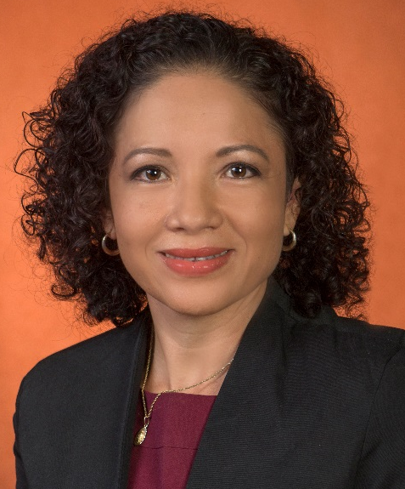
Presenters
Greg Smith
Florida Literacy Coalition
smithg@floridaliteracy.org
Vania Aguilar
ACE of Leon County &
Florida State University
vania.aguilar@fsu.edu

Slide 3
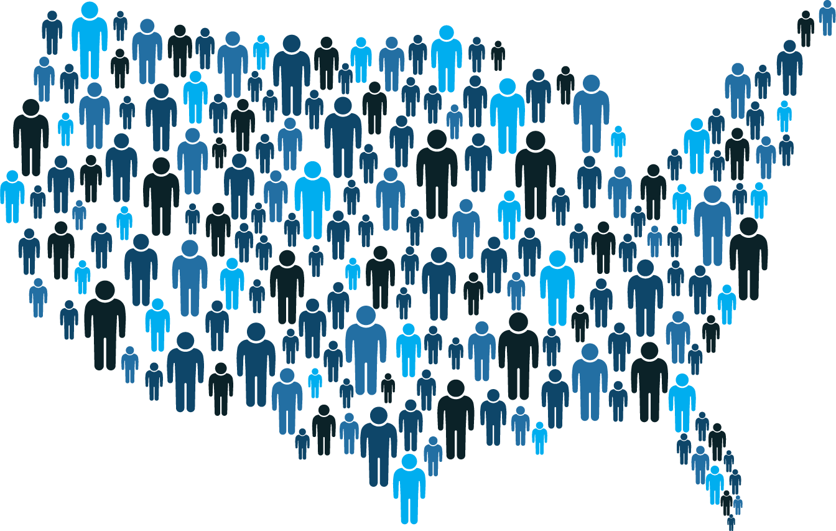
Yes We Count! Census 2020
Every 10 years, the U.S. Census takes a count of every person in the United States. Completing the Census is required by the U.S. Constitution. It’s a way to take part in our democracy and say: "I COUNT!
Notes:
Civic duty, role and function of government, our civic duty as Americans.
EL Civics.

Slide 4
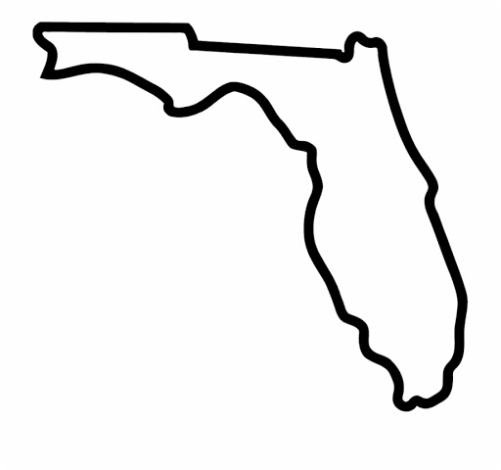


Census 2020
Economic Impact
$650 Billion/year($7 Trillion over the decade) for 2020
$45 Billion for Florida/year
Here are a few federal programs that could be impacted by
the results of the census
Medicaid
Education Grants, including Adult Ed.
SNAP
Section 8 Housing
Highway planning and construction
WIC
National School Lunch
Head Start
Notes:
NOTE
Just an additional 1% undercount in 2010 would result in $178 million loss in funding

Slide 5

Political Representation
Census is constitutionally
mandated for re-apportionment of Congress.
Census results are used for redistricting at national,
state, and local levels.

Slide 6
Florida is home to large numbers of traditionally hard-to-count groups
Nearly 30 percent of Floridians speak a language other than English at home
Many people in traditionally hard count groups are served by adult education programs.
Why do we need to care?
Notes:
Traditionally hard to count - adult ed is well positioned to
Persons at or below poverty
Persons receiving public assistance, disability, or SSI
Concentrations of minority groups, immigrants,, migrant workers
Low educational attainment (no high school diploma)
Single parents

Slide 7
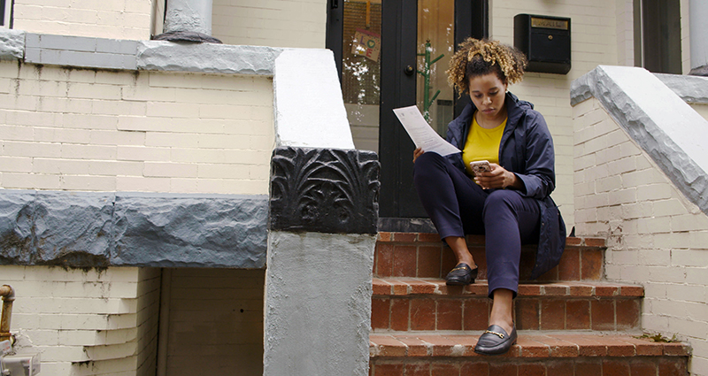
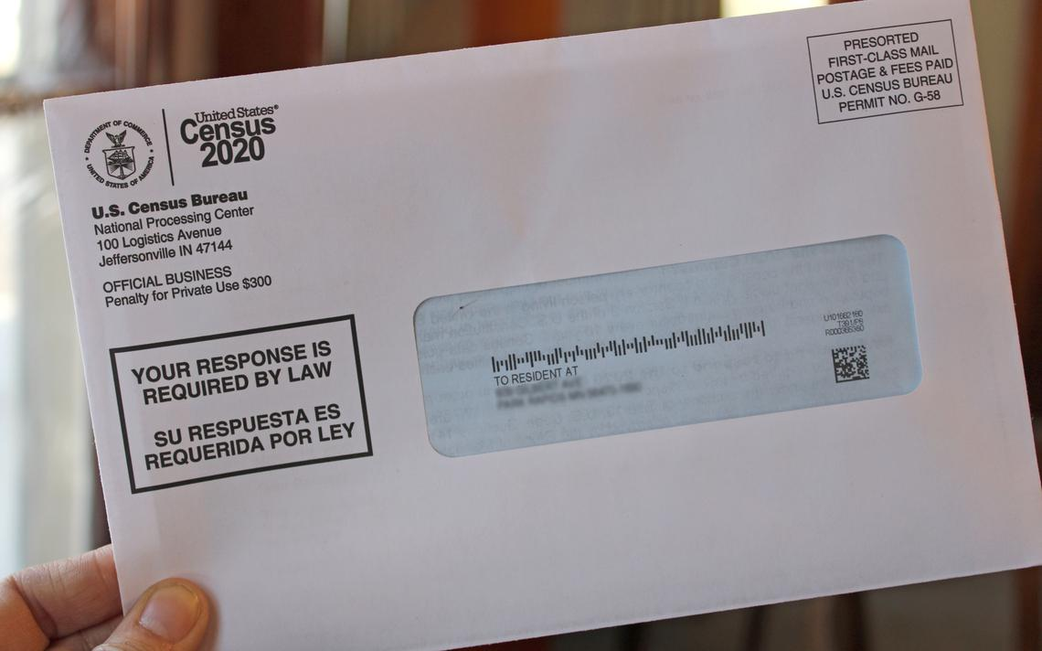

Who is Counted in the
2020 Census?
Every person living in the United States is counted. It doesn’t matter where they are from why they are here, or whether they are documented. You will soon be asked to count everyone who lives in your home as of April 1st, including children and babies.
Notes:
Envelope is addressed to Resident

Slide 8

Your Privacy is Protected
The Census Bureau cannot release any identifiable information about individuals, households, or businesses, even to law enforcement agencies.
Census data are protected by the strictest confidentiality protections in federal law.
The law prohibits sharing your data with federal agencies, immigration authorities, law enforcement, courts of law, or any other government agency, for any reason.
Government workers who violate these privacy protections can be punished with fines of up to $250,000 and jail terms of up to five years.
Notes:
No citizenship question.

Slide 9


Census 2020
Timeline
March 16 –
April 27
April
1
May
28
August
14
Reminder letters sent
Census workers begin visiting households
New self
response deadline
Census Day
Notes:
Discuss April 1 Census Day and what it means.

Slide 10
Invitation
Most households receive a letter asking you to go online complete the Census questionnaire (or respond by phone). A Census ID number will be provided in the letter, to be used when you go online.
Some households will receive a paper questionnaire along with their invitation. The invitation will include how to go online or complete by phone.
The invitation includes the following statement in multiple languages.
Go to my2020census.gov and select (LANGUAGE) located in the upper-right corner of the window, to access your 2020 Census questionnaire in (LANGUAGE)
Online
By Phone
On Paper
Census helpline: 1-844-330-2020
Notes:
The letter will say your responses are required by law and if you don’t respond they will send a Census interviewer to your home.
Watch out for Scams.

Slide 11

Languages
You can fill out an ONLINE CENSUS QUESTIONNAIRE in English, Spanish, Chinese (Simplified), Vietnamese, Korean, Russian, Arabic, Tagalog, Polish, French, Haitian Creole, Portuguese, and Japanese
Or by PHONE in English, Spanish, Chinese (Mandarin & Cantonese), Vietnamese, Korean, Russian, Arabic, Tagalog, Polish, French, Haitian Creole, Portuguese, and Japanese
Or through a PAPER QUESTIONNAIRE in English or Spanish

Slide 12
Avoiding Scams
The Census Bureau will not send unsolicited emails to request your participation. Phishing emails often direct you to a website that looks real but is fake—and may be infected with malware.
The Census Bureau will never ask for:
Your Social Security number.
Your bank account or credit card numbers.
Anything on behalf of a political party.
Money or donations.
If you suspect fraud, call 844-330-2020

Slide 13
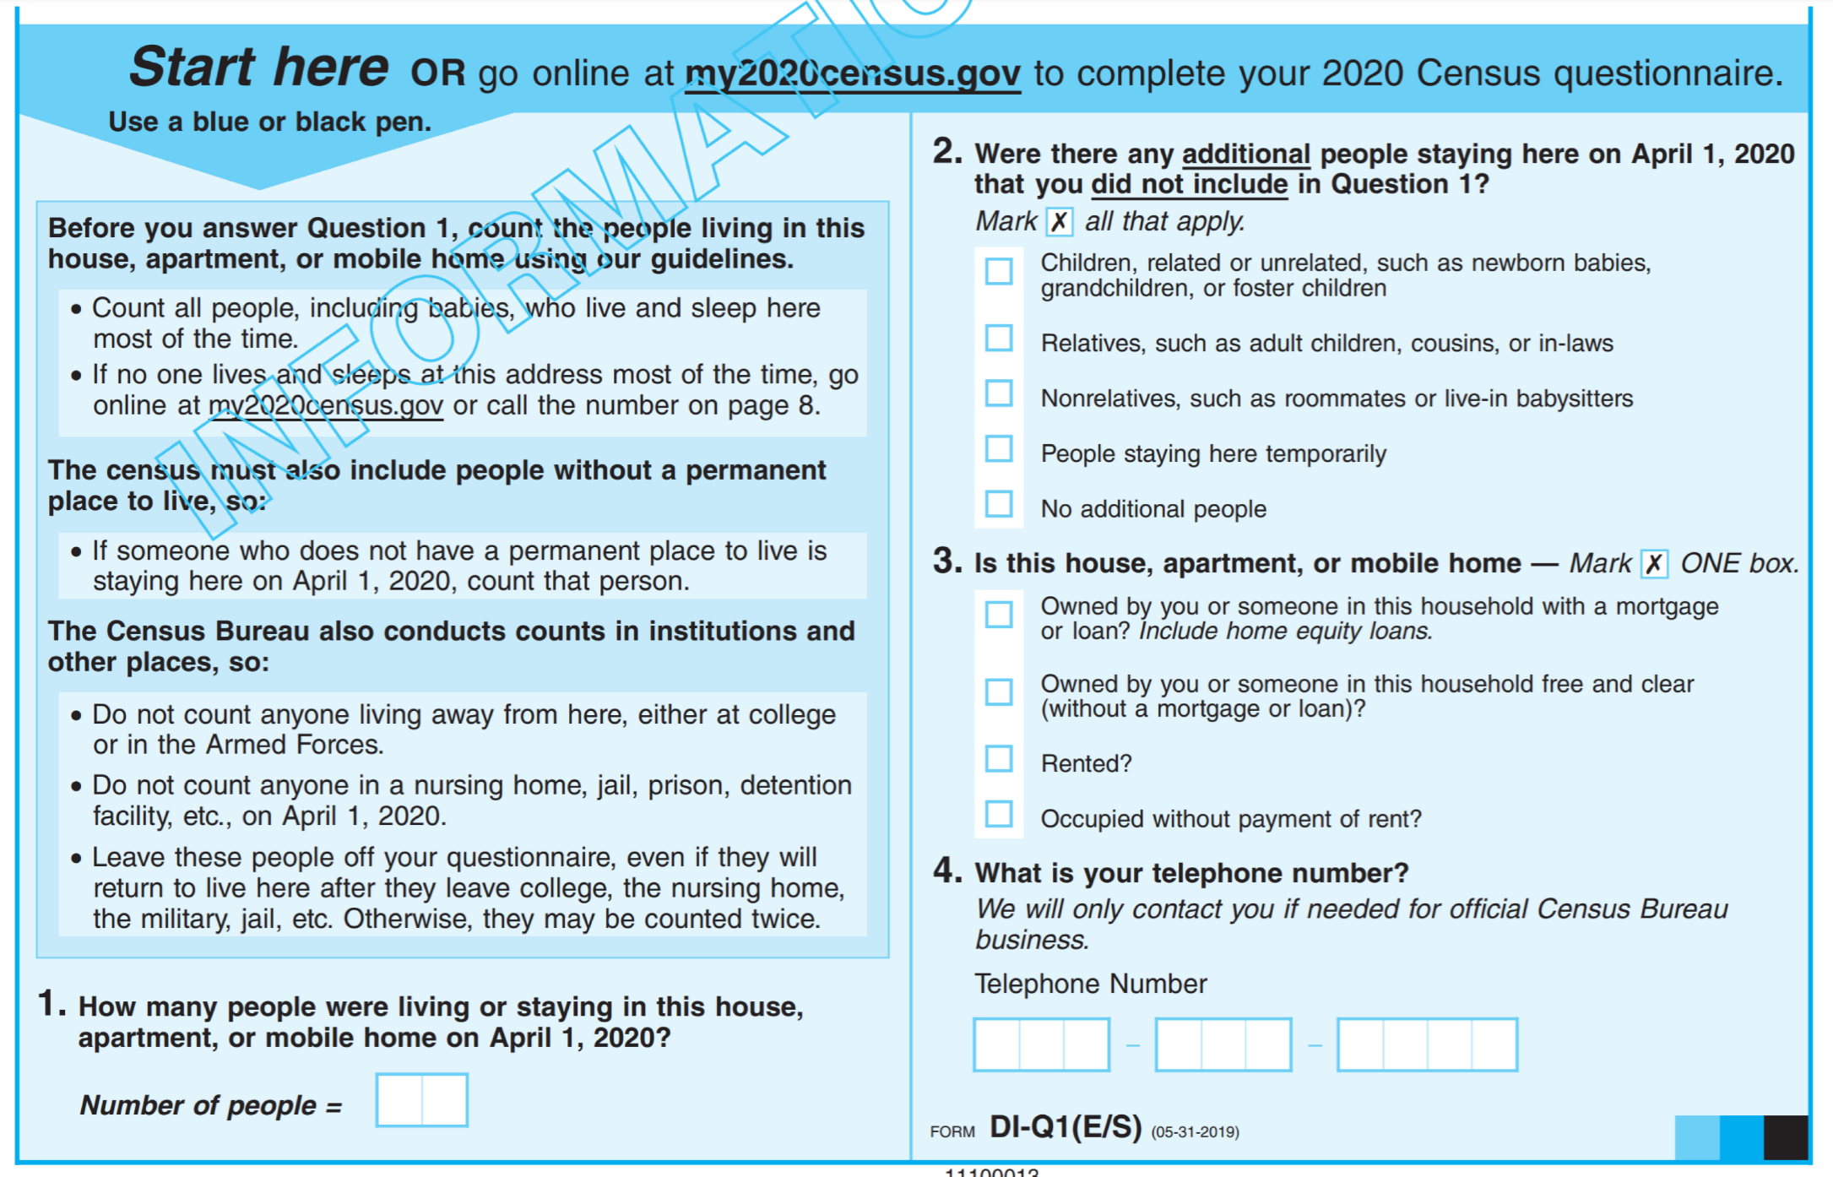
Questionaire
Notes:
Can we make the form a bit larger?
It doesn’t take long – average of 10 minutes.
No Citizenship Question

Slide 14
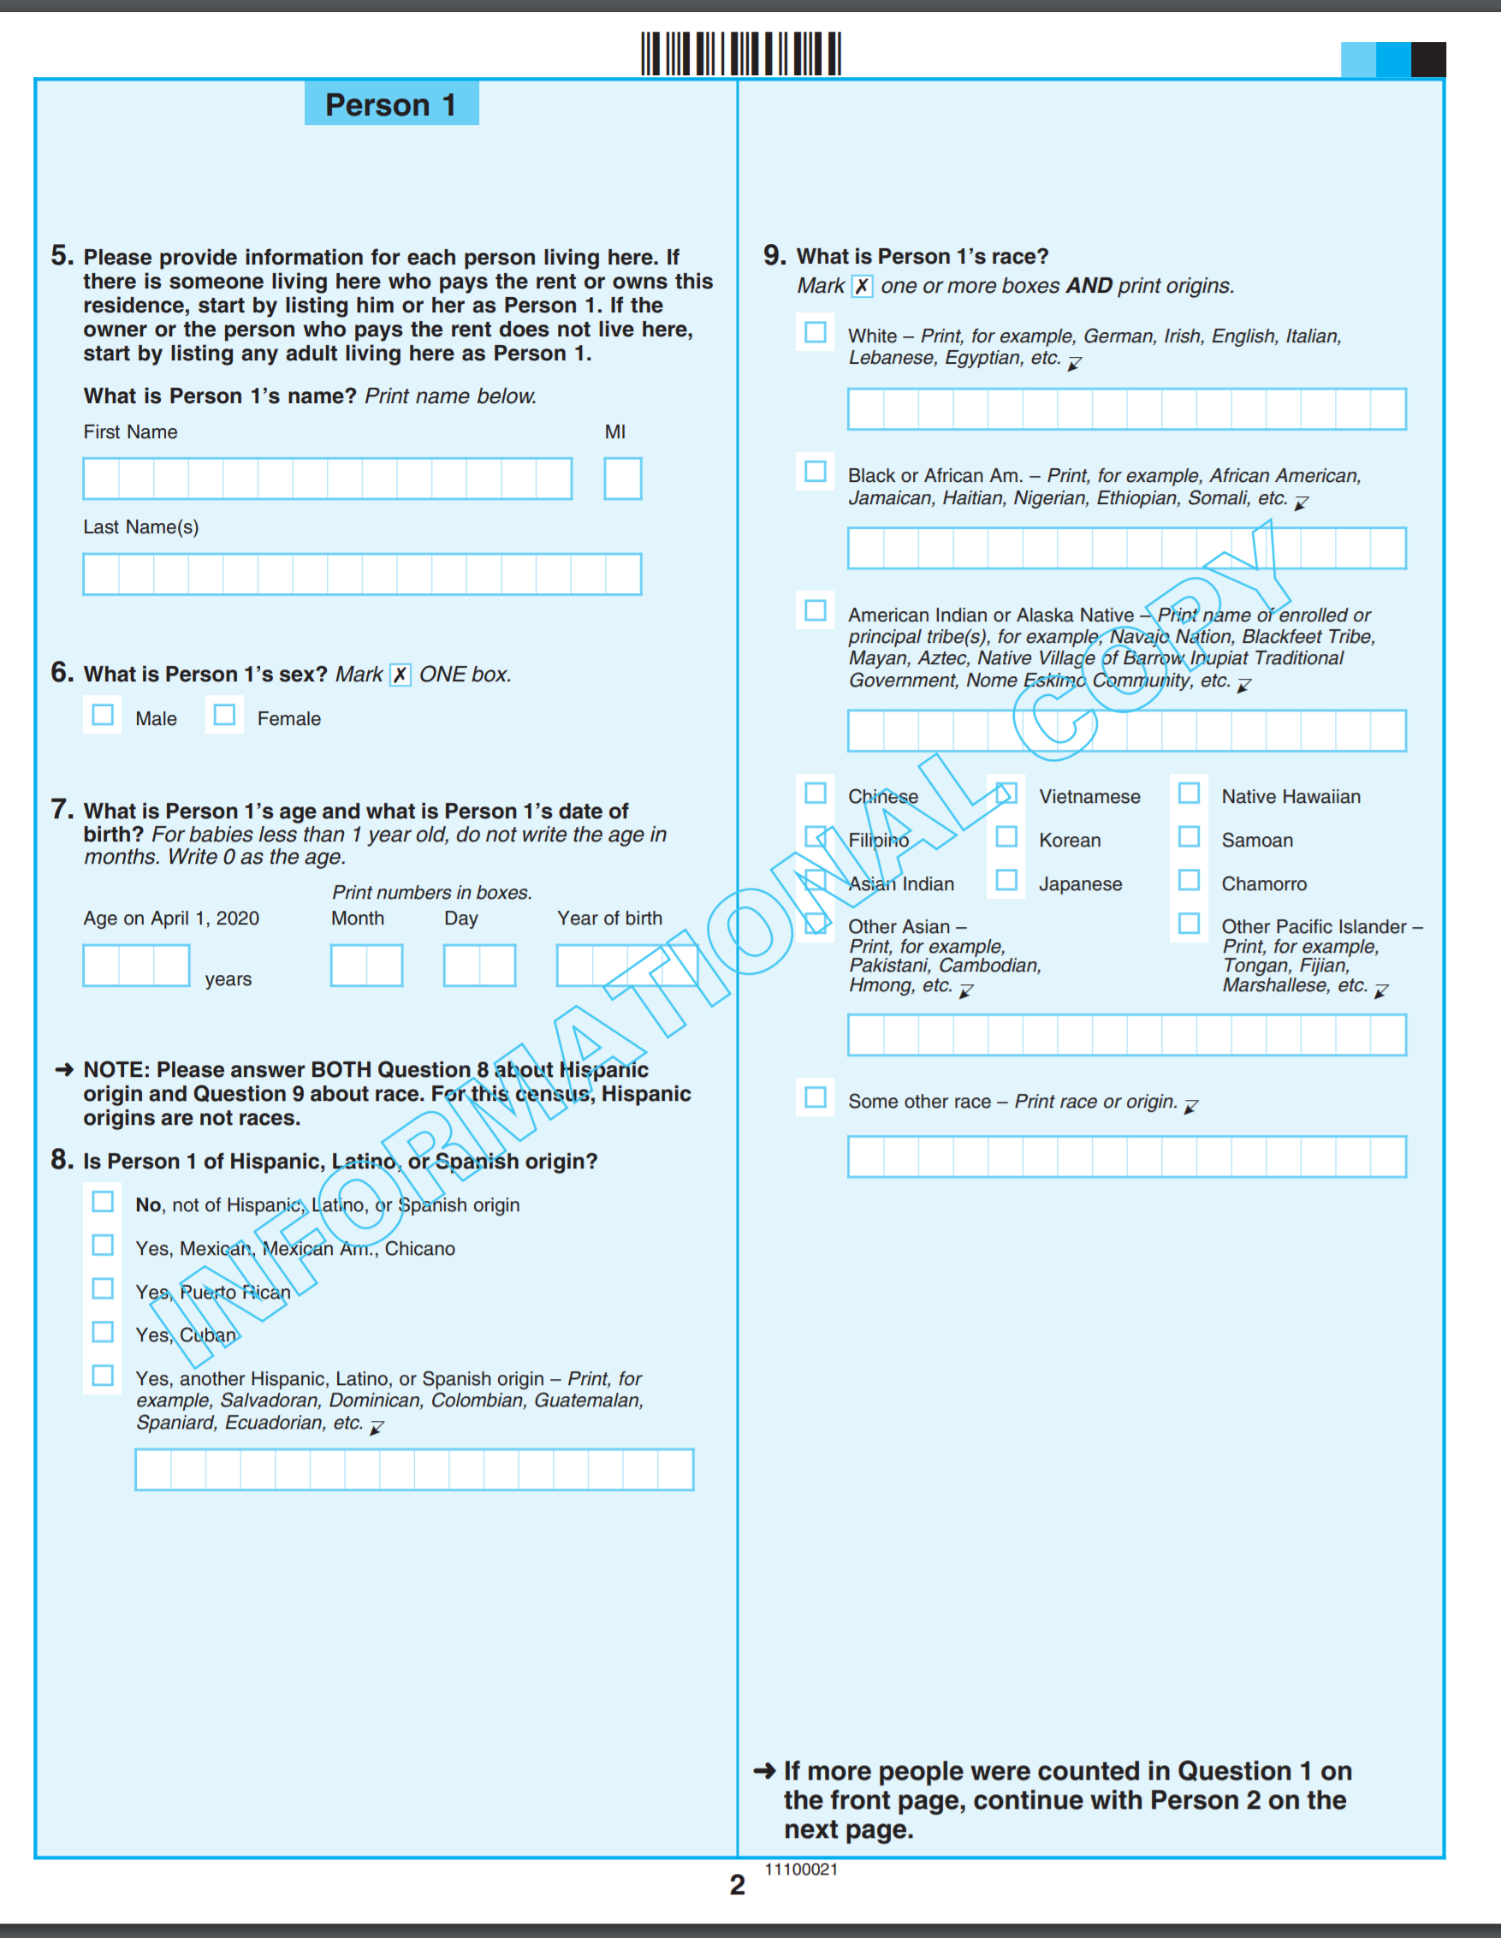
Questionaire

Slide 15
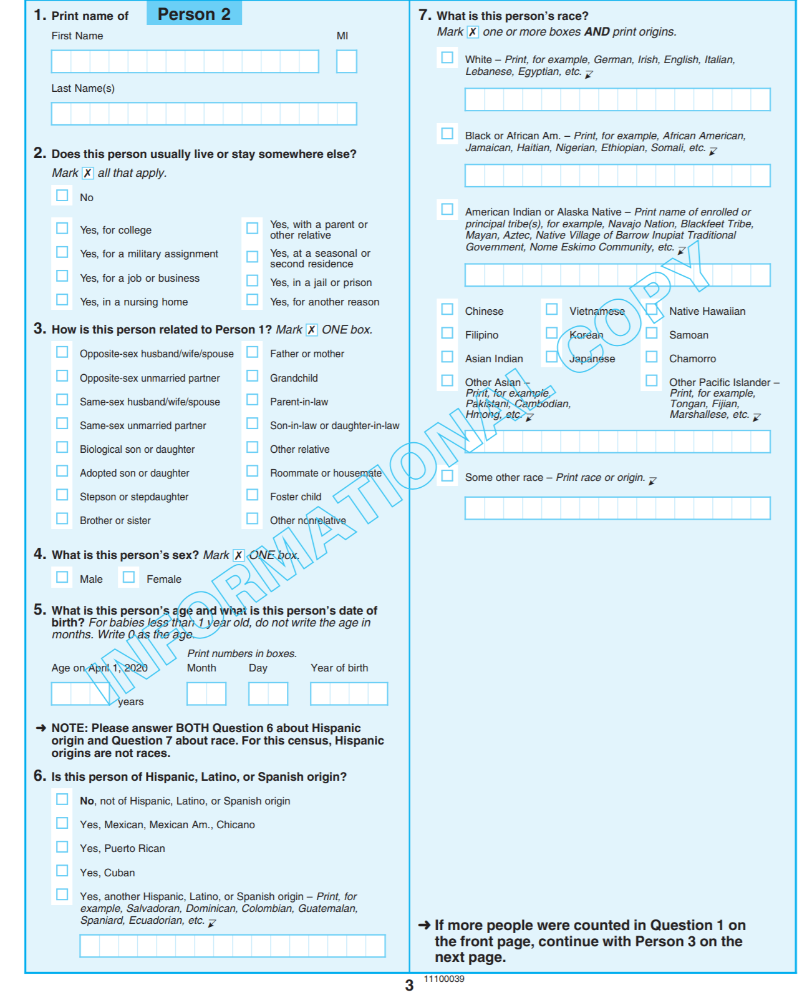
Questionaire

Slide 16

Census 2020
Census 2020 Adult Education Campaign
Census Kits
  Webinars
Lesson Plans
  Resources
https://floridaliteracy.org/2020census.html
Notes:
Go to website

Slide 17
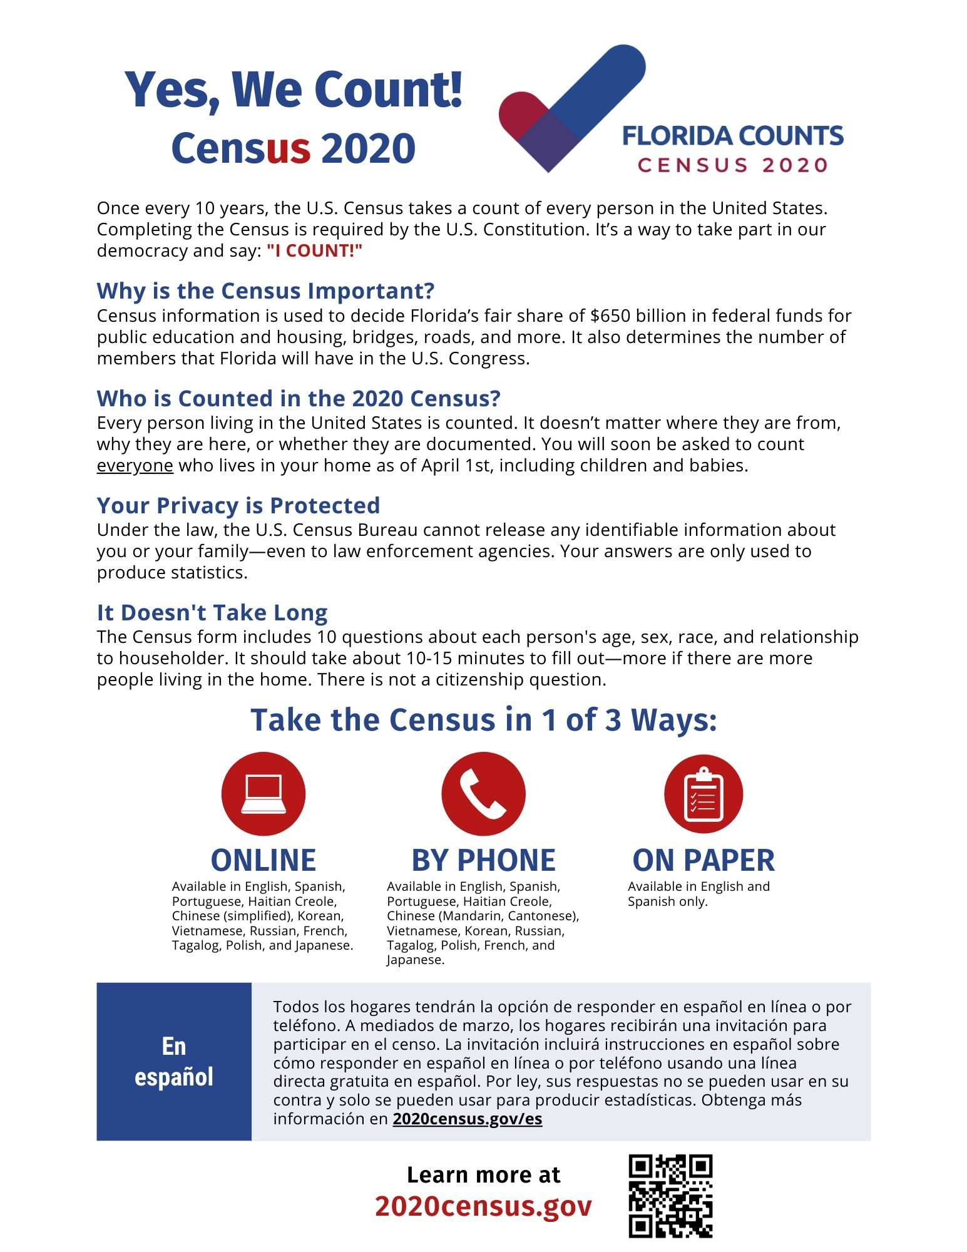
Notes:
Can we add FLC’s Census flyer as a graphic?

Slide 18
Focus of the lessons plans
What is the Census
Why it’s important
Who is counted
Your privacy is protected
How to take the questionnaire
It’s available in multiple languages
What questions are asked on the form

Slide 19
Where to find Census information and lesson plans
Florida Literacy Coalition Census information and lesson plans
  https://floridaliteracy.org/2020census.html
Census flyer
  https://floridaliteracy.org/censustoolkit/Census%20Toolkit%20flyer.pdf
Census website
  https://2020census.gov
Census Questionnaire
    https://my2020census.gov/

Slide 20
Lesson plans and Activities
Beginners
  Activities include: video clip, reading with pictures and limited text along with questions, and dialogue practice.
Intermediate
  Activities include: video clip, reading along with questions, and a handout on step by step on how to complete the census questionnaire with key information on what to complete.
Advance
  Activities include: KWL activity, video clip, reading along with questions, and a handout on step by step on how to complete the census questionnaire with key information on what to complete.
Online classes
  A PowerPoint Presentation has been developed with the key information that needs to be shared with student along with a walkthrough a step by step walkthrough of the online survey

Slide 21
Lesson plans walkthrough

Slide 22
Beginners
There is a lot of information for this level to understand everything
Break the information into smaller sections
Use as many visuals as possible
Encourage students to visit the Census website and get the information in their own language
Introduce the information in class with the videos and handouts.
Break class into groups to cover the information
Practice dialogue with your students so that they feel more confident answering the census questionnaire

Slide 23
Intermediate
This group has more command of the English language but the information should still be broken into smaller sections
Encourage students to visit the Census website and get the information in their own language
Introduce the information in class with the videos and handouts.
Practice the walkthrough of the on-line census questionnaire

Slide 24
Advanced
Students in the advanced level normally are able to have more discussion and conversations.
Use the KWL approach; worksheet is included; this will give you a good idea of what they need know and what else to cover
A longer reading comprehension activity has been developed for this group
Introduce more information with video link listed on the lesson plan.
Practice the walkthrough of the on-line census questionnaire

Slide 25
Online teaching
PowerPoint will be found on the website along with all the lesson plans
This can be shared through media such as: Edmodo, Google hangouts, email, etc.
Recorded sessions through Zoom, Join.me, Skype, etc.
Do you have different ways to share with information.

Slide 26
Resources
Information
  https://2020census.gov
  https://floridaliteracy.org/2020census.html
Videos
  https://www.youtube.com/watch?v=oXZAe8XYeNQ
  https://www.youtube.com/watch?v=Eq-FMB4epyw
  https://www.youtube.com/watch?v=895dO2hBdqk
Census Questionnaire Practice
  https://nelrc.org/courses/practice_census/story.html

Slide 27
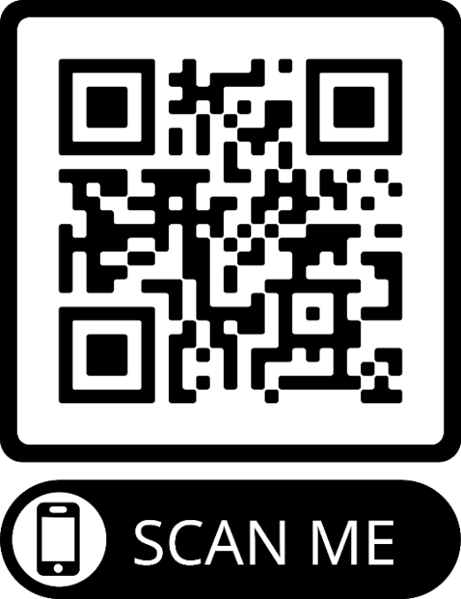

Census 2020
Online Resources
Census.gov
Florida Literacy Coalition Blog
National Coalition for Literacy

