Slide 1
2020 census
FLORIDA COUNTS
YES, WE COUNT!
Lesson developed by Vania Aguilar from ACE of Tallahassee Funded by the Florida Literacy Coalition

Slide 2
What is the Census?
It’s a headcount of everyone who lives in the United States.
It takes place every 10 years.
It’s not a choice; the U.S. Constitution requires it.
It’s a way to show your democracy
It’s a way to say “I C0UNT”!

Slide 3
Why is the Census important?
The information collected is used to decide how much of the $650 billion in federal funds Florida will receive.
This money is used for public education, housing, bridges, roads, and more.
It also determines the number of representatives Florida will have in Congress.

Slide 4
Who is counted in the 2020 Census?
Everybody living in the United States counts
US Citizens
Immigrants
Undocumented people
People from every country living in the United States on April 1st, 2020

Slide 5
Is your information confidential?
Your privacy is protected
Your answers are only used for statistics
The law says your answers will not be shared with law enforcement
Not with the police
Not with ICE
ALL YOUR INFORMATION IS COMPLETELY CONFIDENTIAL

Slide 6
What does the Census Bureau ask?
It’s a short questionnaire about your name, age, sex, race and relationship to the householder
It only takes about 10-15 minutes
There is no question on citizenship

Slide 7
How do I complete the Census?
On-line at my2020census.gov
By mail
By phone
Arabic: 844-416-2020
Tagalog: 844-478-2020
Polish: 844-479-2020
French: 844-494-2020
Haitian Creole: 844-477-2020
Portuguese: 844-474-2020
Japanese: 844-460-2020
English: 844-418-2020
Spanish: 844-426-2020

Slide 8
Questionnaire on-line practice
The link to the on-line practice is https://nelrc.org/courses/practice_census/story.html
This practice allows people to view the questions and go through the entire survey without submitting their questions.
The real questionnaire can be found at https://my2020census.gov/
There are questions on the real questionnaire that people may skip and still be counted
Phone number
Details on origin
Race
You cannot click on the back button when you are on the questionnaire, there will be an option on the survey that says “Previous” to go back to any screen.

Slide 9
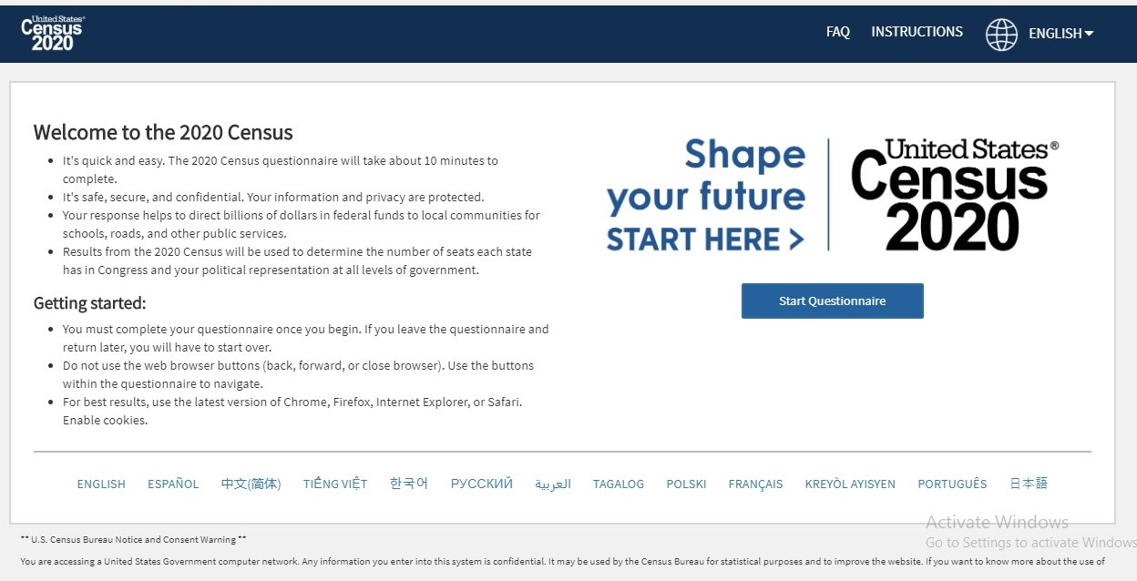
This is how the Questionnaire looks. Remind your students that they have the option to complete the Questionnaire in their own language. They can click either on the language options at the bottom of the screen or click on the word English to change it to their language. To begin click “Start Questionnaire”

Slide 10
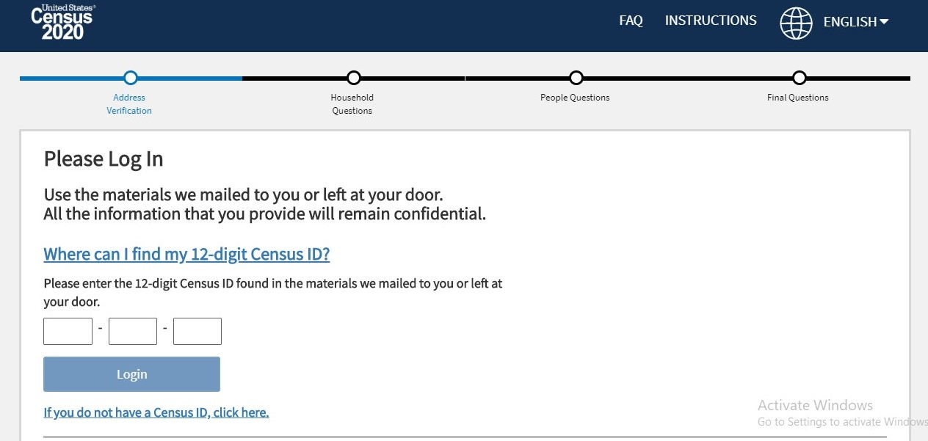
Enter your Census ID number here then click login to move to the next screen.
If you didn’t receive an invitation letter and do not have a Census ID number, you can click on this section to move forward.

Slide 11
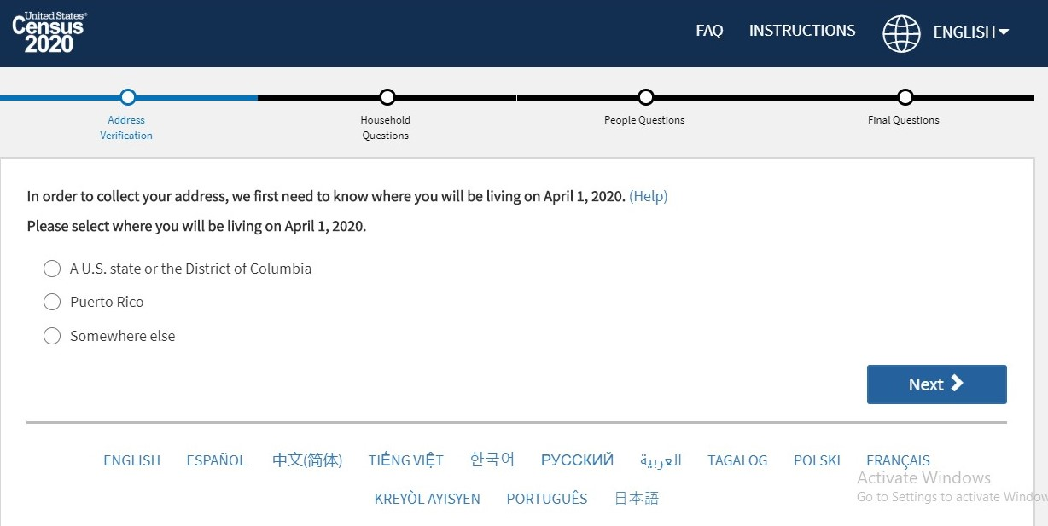
Select one of the options above, and it will take you to the next screen where you will enter your address.

Slide 12
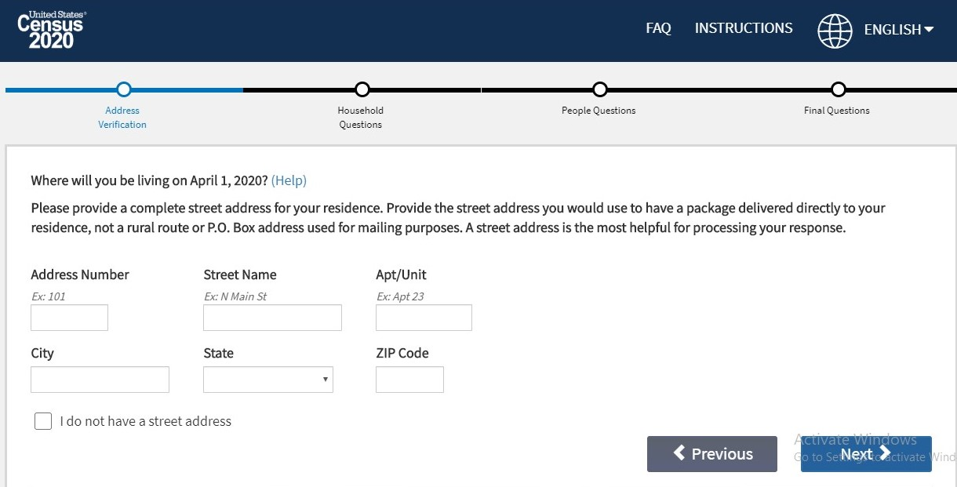
Enter your address here. From this point on, all the other questions will be the same as if you had entered a Census ID number.

Slide 13
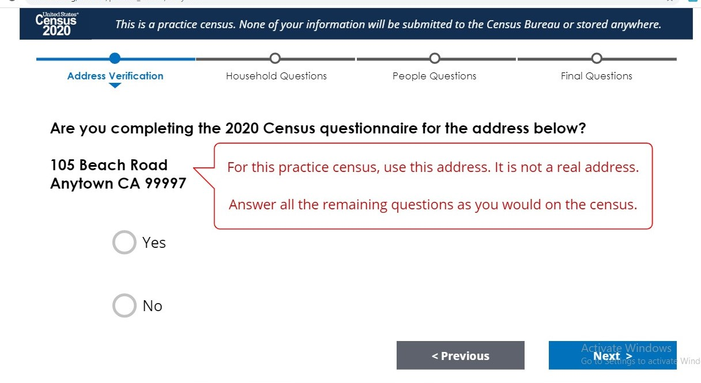

Slide 14
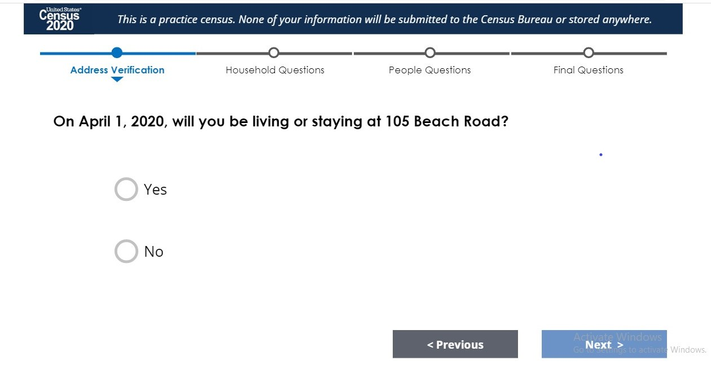

Slide 15
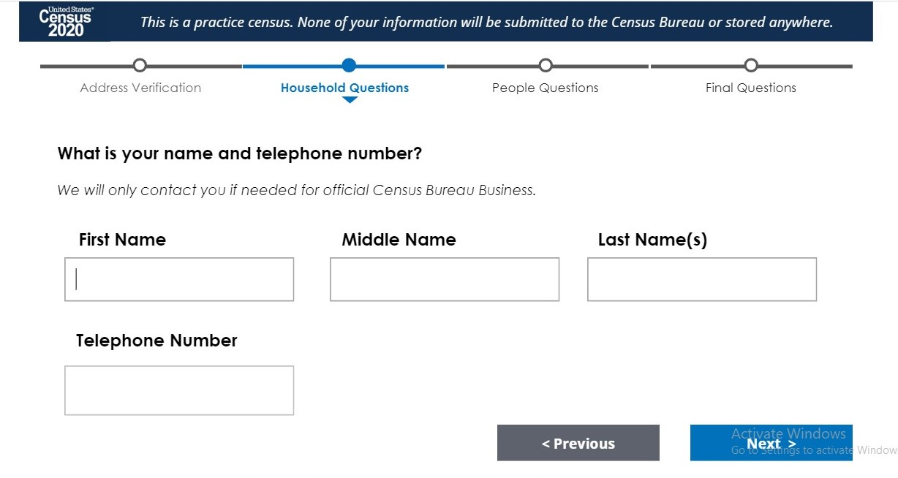
This will screen asks for your phone number. If you don’t have one or don’t want to disclose it, you can press next. A red box will appear, click next again and it will move to the next screen.

Slide 16
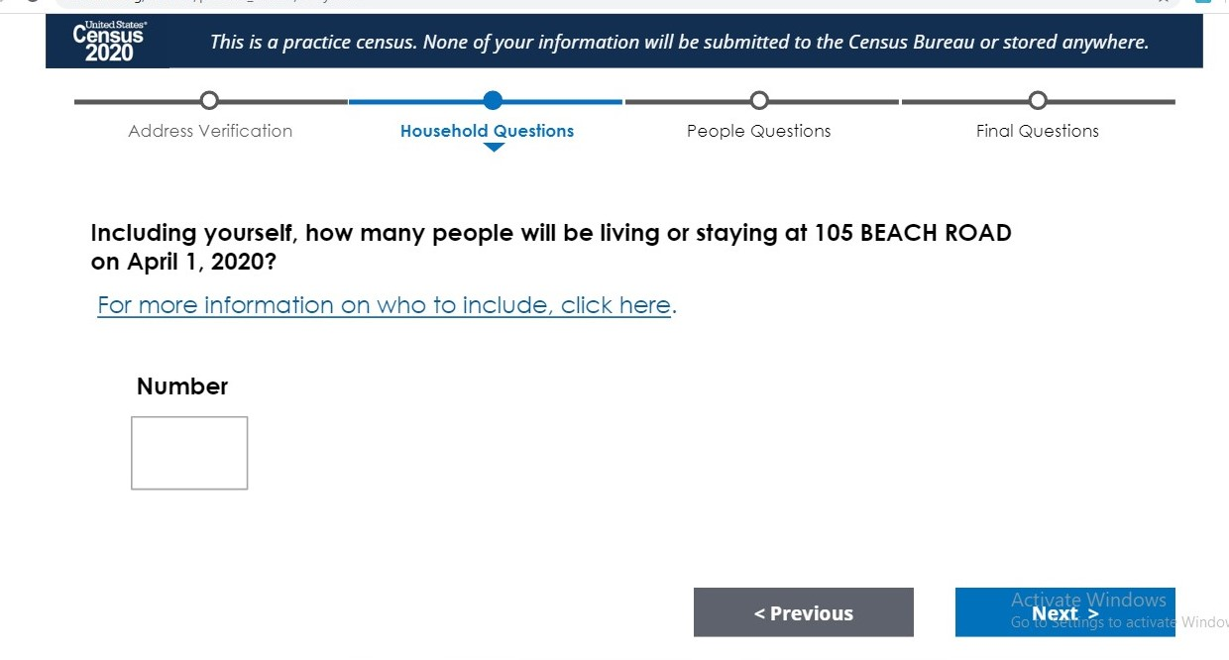
Enter the number of people living in your home; you will enter information about each person starting with you.

Slide 17
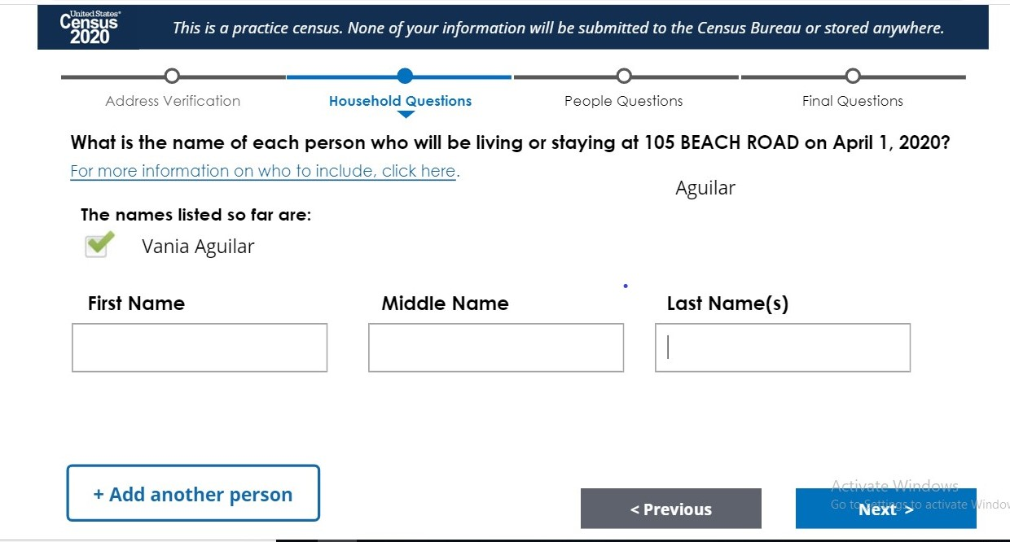
You can enter the next person’s name and click on “Add another person” to enter more people.

Slide 18
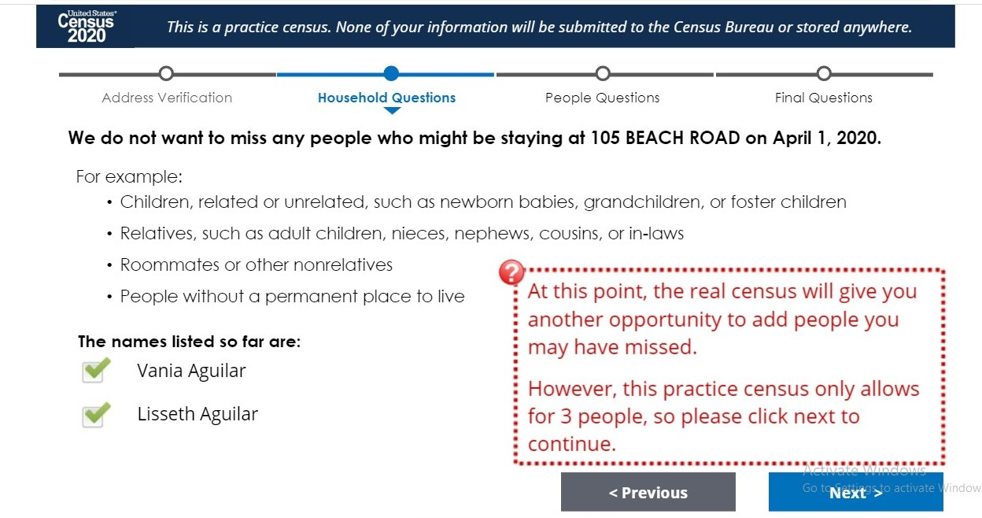

Slide 19
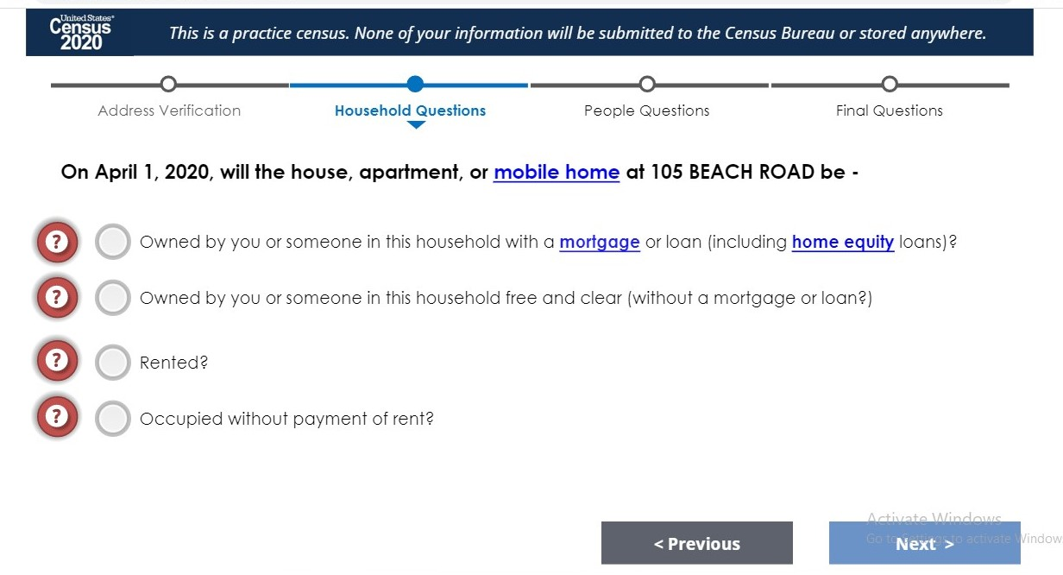

Slide 20
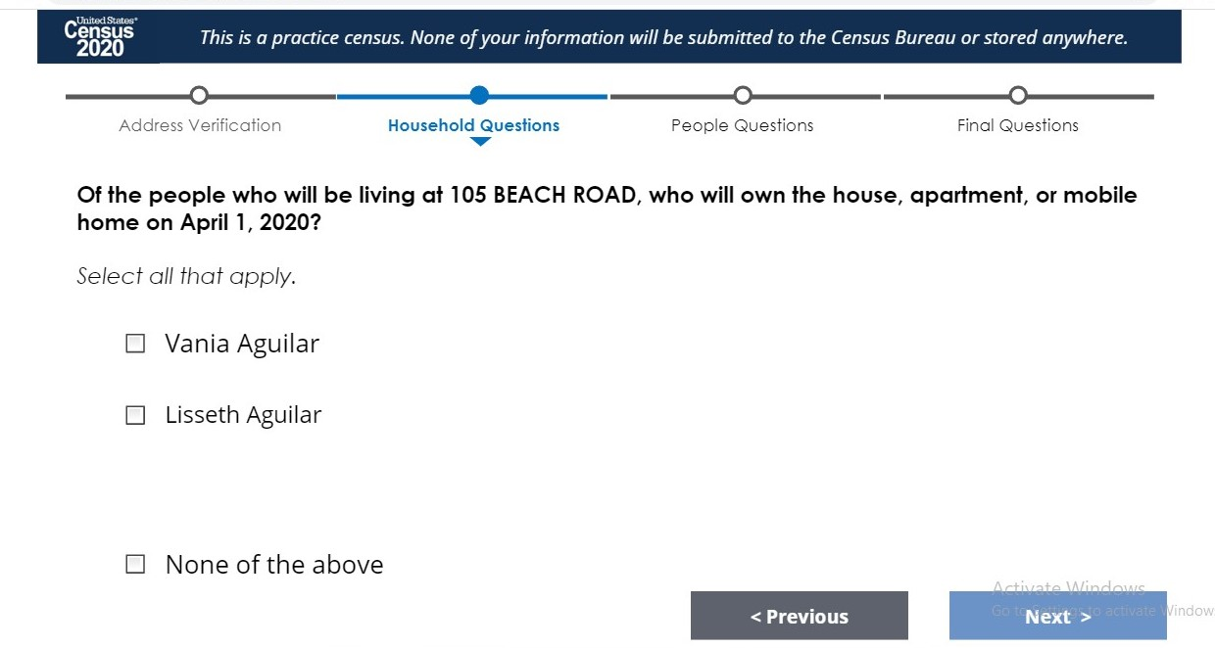
If you or the other people listed don’t own the place where you live, select “None of the Above”

Slide 21
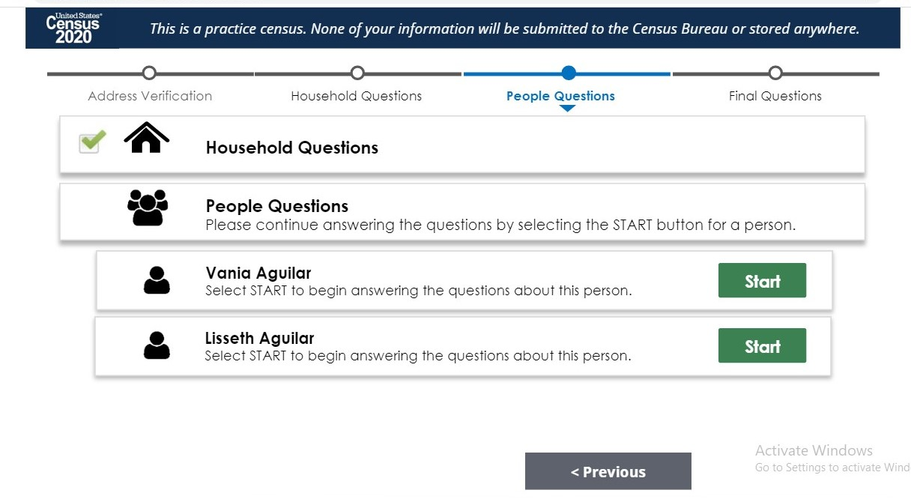
At this point, the questionnaire will ask questions about each person. You have to press “start” on each person to enter the information for each person. There is no “next” button.

Slide 23
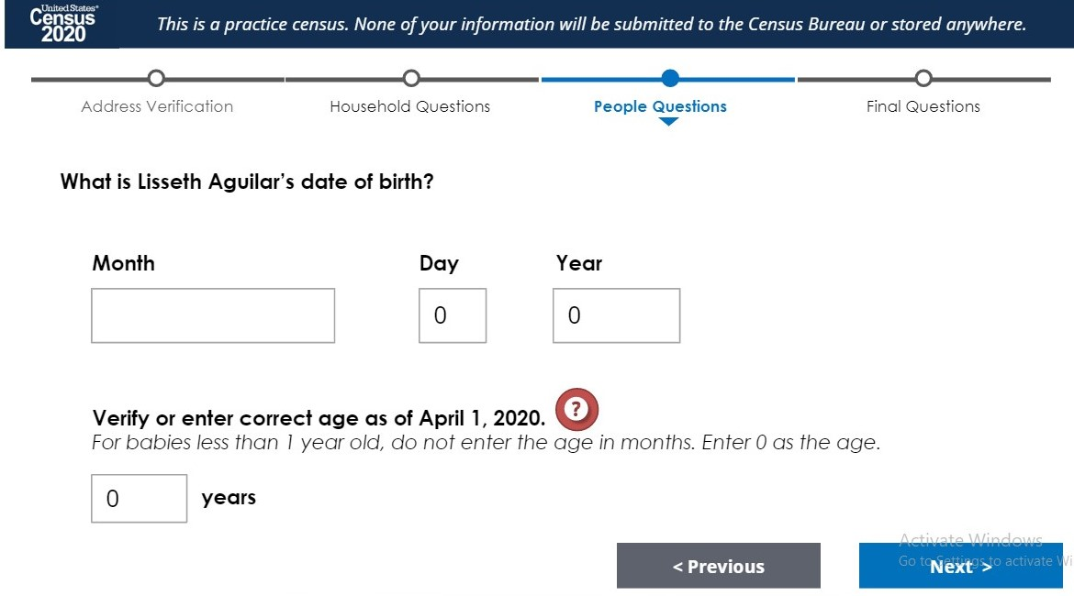
This information is required; It will not let you move to the next screen if you do not answer.

Slide 24
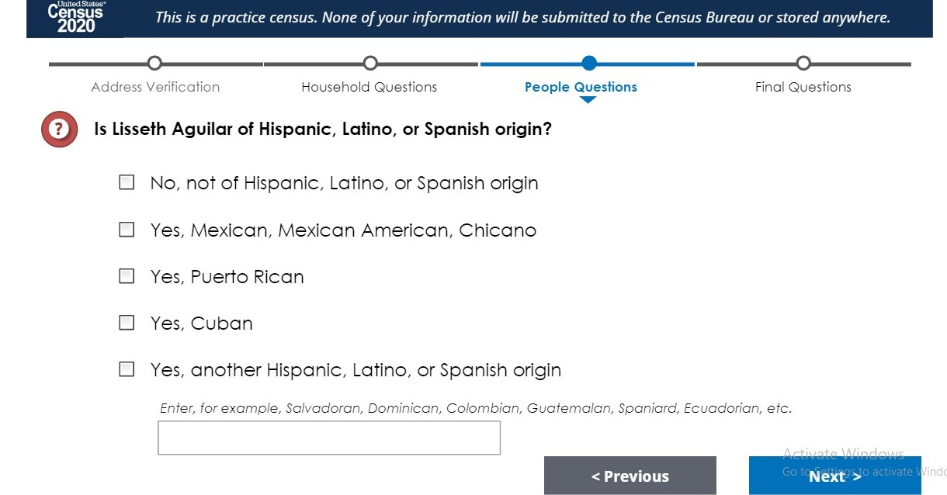
If you mark another Hispanic, Latino, or Spanish origin, you don’t have to enter anything else on the box that follows. Click next once and a red box will appear then click next again and it will move forward. However, you can also enter the information if you choose to and then click next.

Slide 25
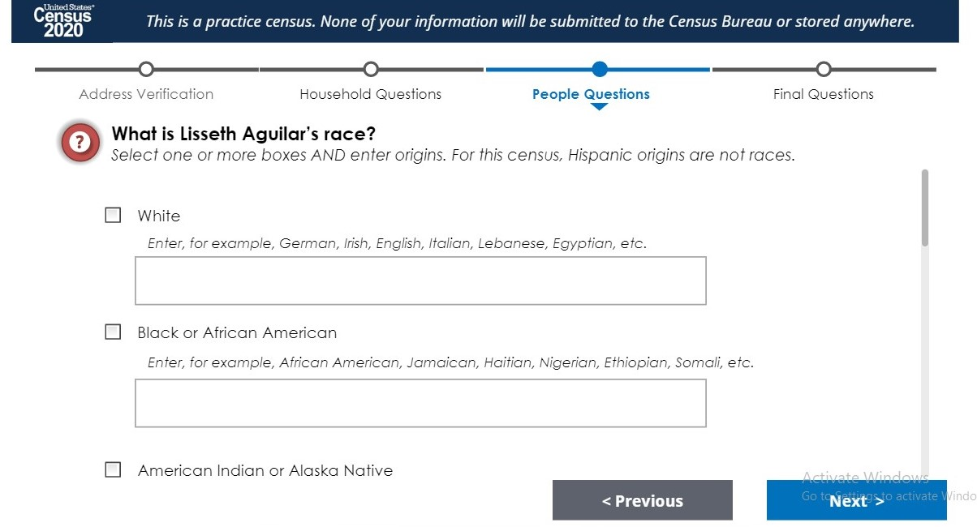
If you are unsure about this question or don’t want to disclose, you can skip it. Click next twice and it will move to the next screen. Please note that for the Census “Hispanic” isn’t a race.

Slide 26
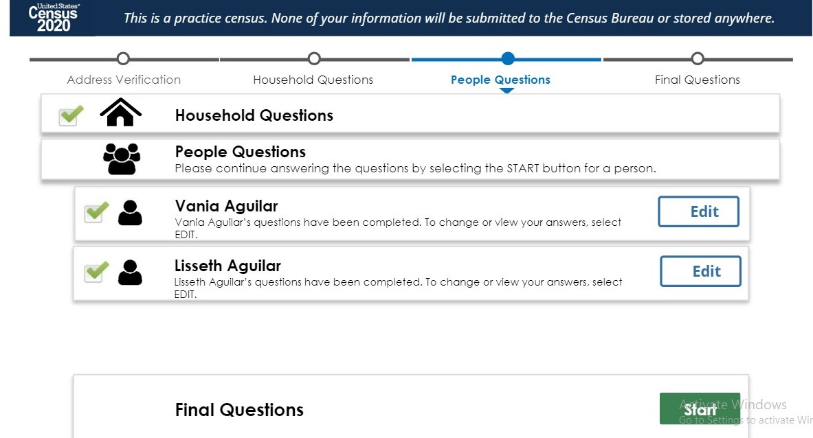
Once you have entered the information about everyone in your home, click on the word “Start” to answer the last section of the survey.

Slide 27
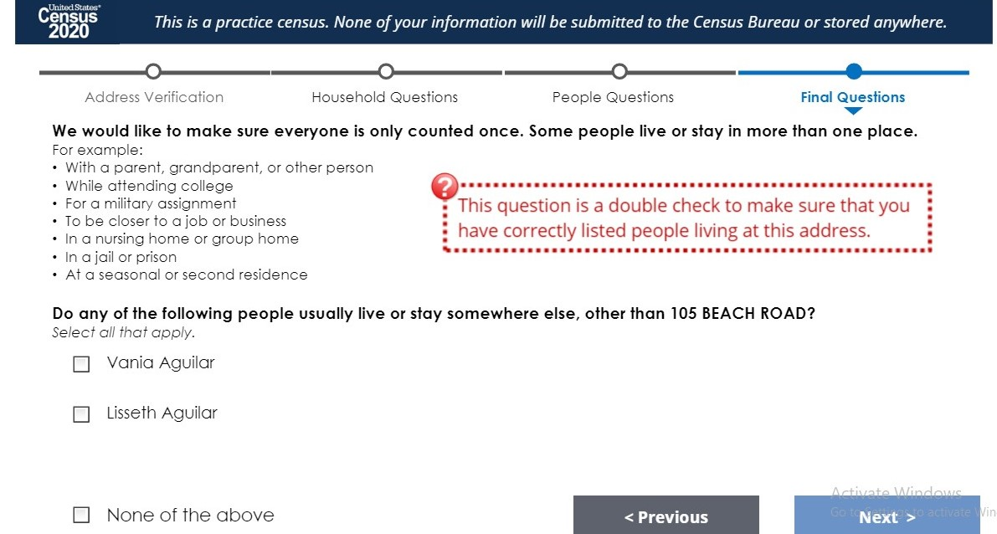
If someone counted on your household lives somewhere else for any reason, click on the person’s name and the next screen will follow. (This could be due to school, work, nursing home, etc.)

Slide 28
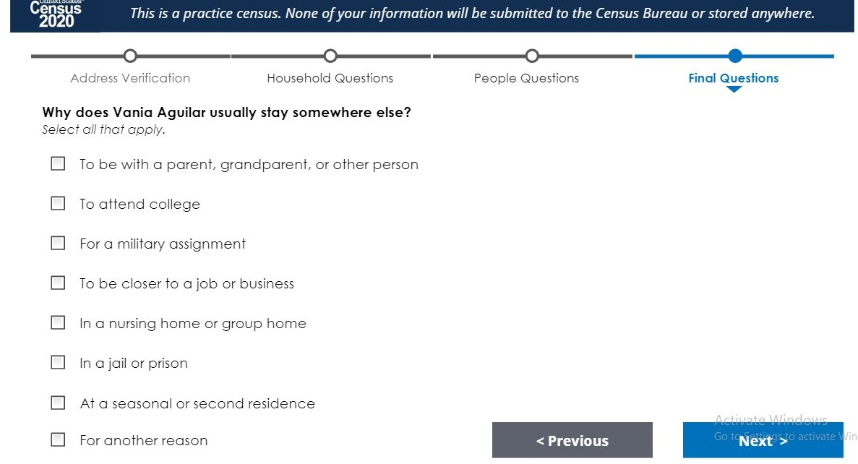
Select the correct answer if it applies and it will take you to the screen for final submission.

Slide 29
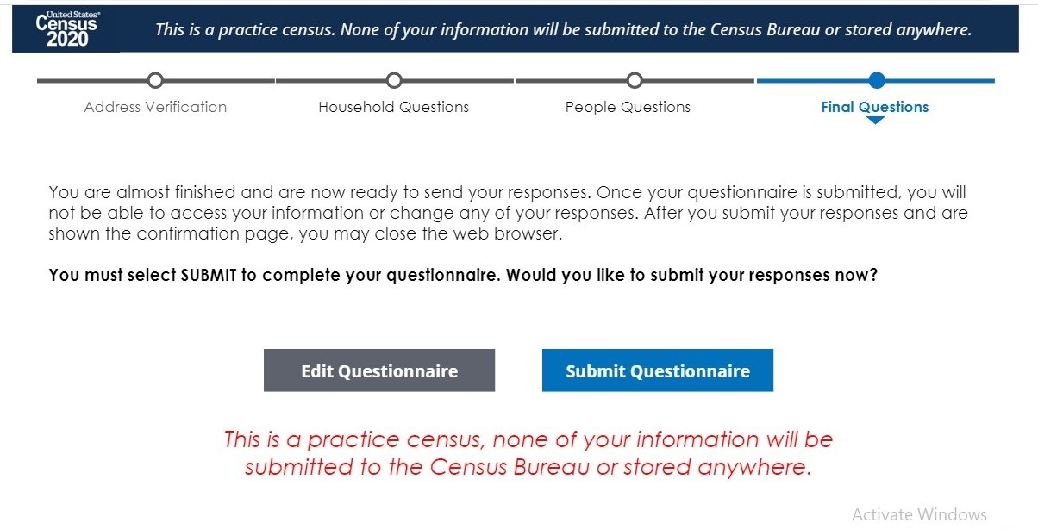
Once you click on “Submit Questionnaire”, you cannot go back to any of the previous screens.

Slide 30
Resources
Information
https://2020census.gov
https://floridaliteracy.org/2020census.html
Videos
https://www.youtube.com/watch?v=oXZAe8XYeNQ
https://www.youtube.com/watch?v=Eq-FMB4epyw
https://www.youtube.com/watch?v=895dO2hBdqk

