Slide 1
CoVid-19
LESSON 4: Stress and Pandemics
Find Press it to turn red when you aren’t talking.
Have a paper and pencil ready to use
HEALTH LITERACY WORK GROUP

Slide 2
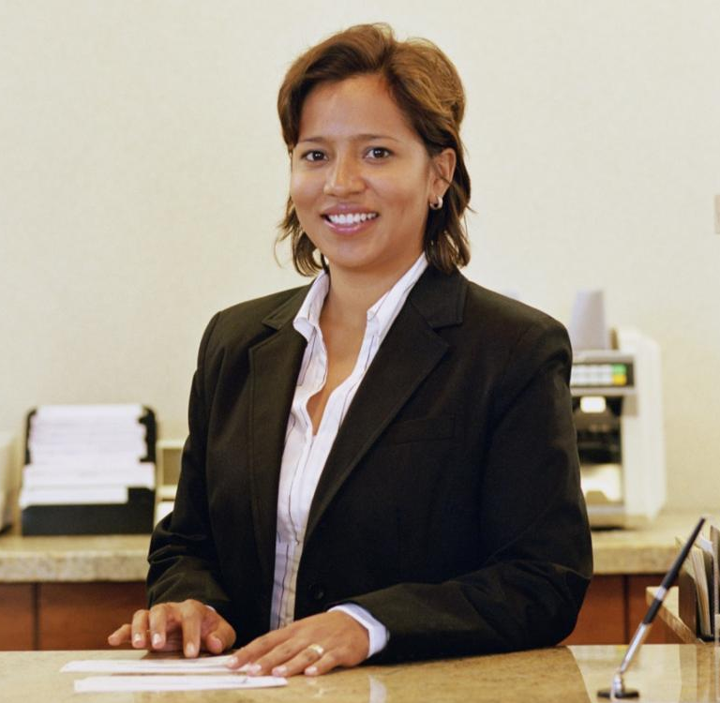
Juanita’s Family Worries
Juanita is finally feeling better and now joins her family for meals. Frank is looking for a job but he says he will never be hired and they will end up in a homeless shelter. She notices that he is drinking and smoking more. Her mother, Maria, is taking her temperature every hour on the hour and she has not been able to sleep. Juanita’s daughter, Mary, is worried that Juanita will get sick again and die. She thinks she will never go back to school or see friends.
She can see that her family members are very worried. What can she do?
Juanita goes to the CDC website. https://www.cdc.gov/coronavirus/2019-ncov/daily-life-coping/managing-stress-anxiety.html?CDC_AA_refVal=https%3A%2F%2Fwww.cdc.gov%2Fcoronavirus%2F2019-ncov%2Fprepare%2Fmanaging-stress-anxiety.html

Slide 3
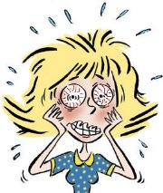
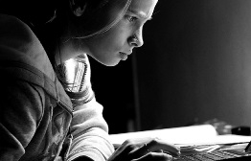
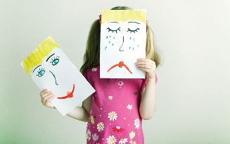
Here are the words she looks up
Stress: What we feel in our body when we fear losing something we care about. Our heart beats faster. We have sweaty palms and stomach aches.
Concentrating: Directing your mind toward one thing.
http://craft-therapy.blogspot.com/2011_01_01_archive.html
-cc-by-nc-nd 3.0
http://www.design-4-sustainability.com/feeds/newsfeed/2011/6?gp=10
CC BY-SA 3.0
Worsening: becoming worse (bad gets worse)
Chronic health problems: Health problems that don’t go away
Mental health conditions: Problems that people have with their thinking, emotions, behaviors or relationships.
https://www.chiangraitimes.com/health/what-to-do-if-you-think-your-child-is-suffering-from-mental-illness/

Slide 4
Matching
Chronic health problems
Mental health conditions
What we feel in our body when we risk losing something we care about
Problems with thinking, emotions, behaviors or relationships.
Directing your mind to one thing
Health problems that don’t go away
Getting worse
Stress
Concentrating
Worsening

Slide 5
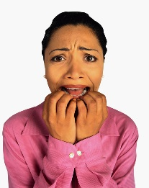
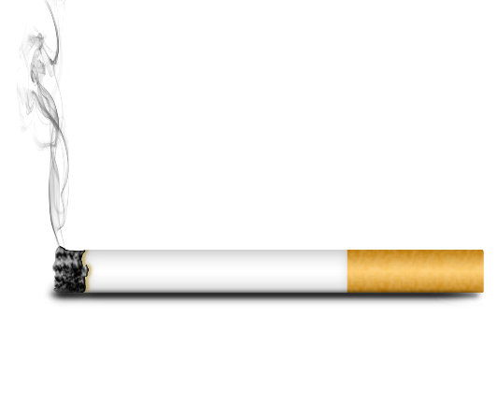
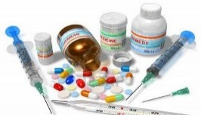
This is what Juanita finds: The Stress of the CoVid-19 outbreak can include:
Fear and worry about your own health and the health of your loved ones
Changes in sleeping or eating
Trouble concentrating
Worsening of chronic health problems
Worsening of mental health conditions
Increased use of alcohol, tobacco, and other drugs
http://teacherwritebookaholicohmy.blogspot.com/2012_07_01_archive.html
CC BY-NC-SA 3.0
http://news.schoolsdo.org/2016/02/kids-who-go-to-bed-early-have-higher-gpas/
CCBY-NC-ND 4.0
http://www.design-4-sustainability.com/feeds/newsfeed/2011/6?gp=10
https://pxhere.com/en/photo/1456499 CC0
http://pngimg.com/download/4751 CC 4.0 BY-NC
Drugs_1 by actsofcompassionproject.org & eLimu used under CC_BY-SA

Slide 6
Word Scramble
health/worry/and/about/fear
Fear and worry about health
sleeping/in/changes/or/eating
Changes in sleeping or eating
problems/chronic/worsening/of/health
Worsening of chronic health problems
conditions/worsening/health/of/mental
Worsening of mental health conditions
tobacco/of/use/alcohol/increased/drugs/and/other
Increased use of alcohol, tobacco, and other drugs

Slide 7
CoVid-19 has hurt all of us!

Slide 8
What to Do?
Juanita thinks this sounds like her family. She also knows that she is a little afraid to go back to work. So they aren’t alone.
But what could her family do about this?
She goes back to the CDC website and finds some ideas: https://www.cdc.gov/coronavirus/2019ncov/daily-life-coping/managing-stress-anxiety.html?CDC_AA_refVal=https%3A%2F%2Fwww.cdc.gov%2Fcoronavirus%2F2019-ncov%2Fprepare%2Fmanaging-stress-anxiety.html

Slide 9
Here is what she finds at the CDC
Take breaks from watching, reading, or listening to news stories, including social media. Too much is upsetting.
Take care of your body.
Take deep breaths, stretch, or meditate
Eat healthy meals
Exercise regularly, get plenty of sleep
Avoid alcohol and drugs
Do fun things with family and friends
Talk with people you trust about your worries and how you are feeling.

Slide 10
Word Scramble
news/from/take/breaks/stories
Take breaks from news stories.
body/take/of/care/your
Take care of your body.
deep/stretch/take/breath/or meditate
Take deep breaths, stretch, or meditate
plenty/and/exercise/sleep/of/get
Exercise and get plenty of sleep
about/worries/your/talk
Talk about your worries

Slide 11
Juanita now has some ideas she wants to bring to her family
But, she doesn’t know where to start. She calls her friend Sama. Sama says she found a workbook that helped her figure out what to do. She sends her the link: https://thewellnesssociety.org/free-coronavirus-anxiety-workbook/
The workbook shows Juanita how to build a Stress Resilience Action Plan.

Slide 12
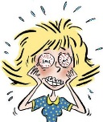
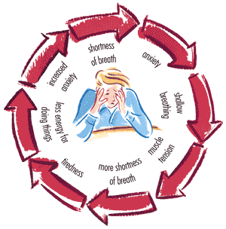
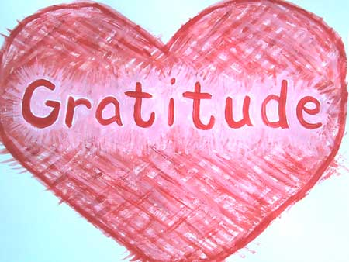
Words from the Coronavirus Anxiety Workbook
Chronic stress : Feeling stress for a long period of time. This can hurt your body (chest tightness, trouble sleeping, muscle tightness)
Anxiety: Unhelpful negative thinking when we don’t know what will happen or we fear losing something we care about.
http://thecollaboratory.wikidot.com/general-psychology1-fa11
CC-SA 3.0
Resilience: being able to get through tough times with few problems
Gratitude the state of being thankful
http://www.desertsojourn.com/thankful-in-all-times/
CC ND 3.0
Distraction: Something that takes your focus away from something else

Slide 13
Matching
Chronic stress
the state of being thankful
Feeling stress for a long period of time
Unhelpful negative thinking when we don’t know what will happen or we fear losing something we care about.
being able to get through tough times with few problems
Something that takes your focus away from something else
Anxiety
Resilience
Gratitude
Distraction

Slide 14
The Stress Resilience Action Plan
Change your “Information Diet”
Make a gratitude journal
Focus on What you Can control
Question your thinking
Distract Yourself from your thoughts
Be Kind to Yourself
Do fun things with family and friends
Take care of your health
Talk to people you trust

Slide 15
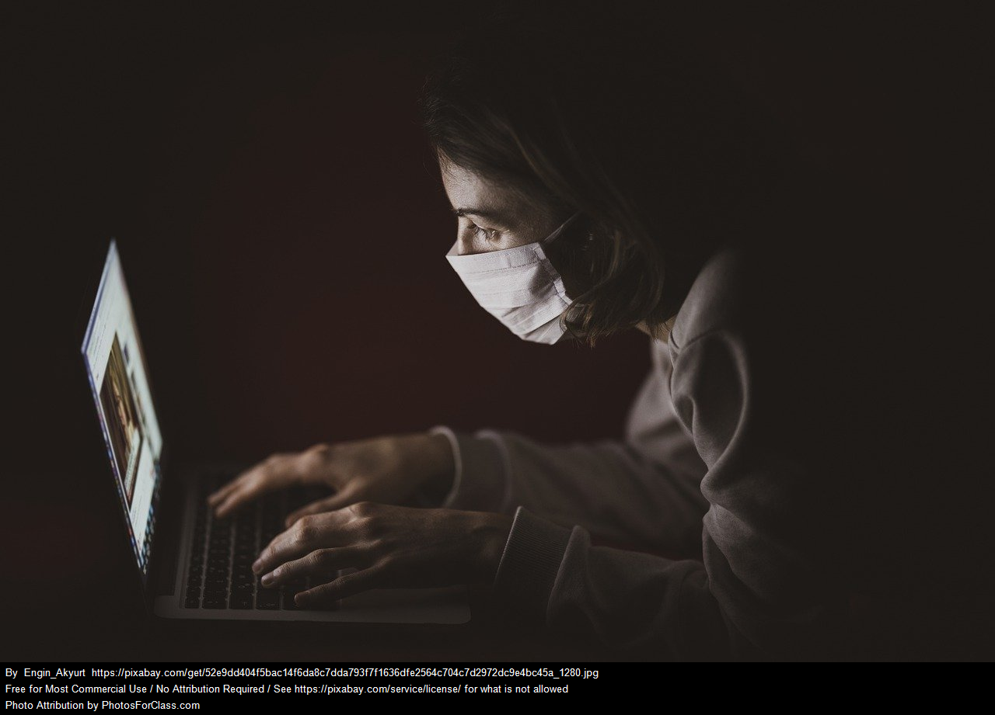
Changing your information “diet”
Most Americans listen or watch information about CoVid-19 more than 2 times a day
This can make you more worried and anxious.

Slide 16
Changing your information “diet”
How often do you listen to news or check on stories about CoVid-19? (take the poll)
1 or 2 times a day
3-5 times a day
More than 5 times a day

Slide 17
Changing your information diet
find a good source for CoVid-19 news (like the CDC and WHO) and check it only once a day
find some “good” news. (Here is one “good news” website https://www.goodnewsnetwork.org/ with many stories about people helping others).
remind yourself that most people who get CoVid-19 have mild symptoms and 97-98% of those who do get it get better.

Slide 18
Make a gratitude journal
Write down one thing you are grateful for everyday.
This can:
Reduce stress and anxiety
Make you happier
Make you healthier, better able to fight off illness
Improve sleep
use the chat to write down one thing you are grateful for today.

Slide 19
Focus on what you can control
What can you control? - What I eat --The news—What the governor does---aging—my information diet---how I exercise—the weather—traffic—other people’s decisions—if I smoke—If I look for good news
What I can control
What I can not control

Slide 20
Question Your Thinking: The Think Technique
True? 100% true, what is fact and what is not
Helpful? Is paying attention to this thought useful to me or others?
Inspire? Does it inspire me or hold me back?
Necessary? Is it important for me to focus on this thought?
Kind? Is the thought kind? It not, what would be a kinder thought?

Slide 21
Practice
Frank is afraid that he will never get a job and the family will be homeless. How can he use the T-H-I-N-K model to question his thinking? Pick one of the questions. How would this help Frank?
True? 100% true, what is fact and what is not?
Helpful? Is paying attention to this thought useful to me or others?
Inspire? Does it inspire me or hold me back?
Necessary? Is it important for me to focus on this thought?
Kind? Is the thought kind? It not, what would be a kinder thought?

Slide 22
Distract yourself from negative thoughts
Find something to do (preferably with other people) that uses your mind.
Play games: virtual or board games
Learn something new
Make something for someone you love
Make a “Now that I have more time, I get to…” list
Prepare for a 5 K race

Slide 23
Practice
Maria knows that at her age if she gets CoVid-19 she could get very sick and even die. How could she distract herself from these negative thoughts and become more resilient?

Slide 24
Be kind to yourself
Covid-19 has changed our world, left us wondering what is going to happen, and can be dangerous.
It is normal to be anxious and overwhelmed

Slide 25
Practice deep breathing, meditation or prayer
Breath slowly from your belly for one minute
Practice meditation
Practice prayer if that is part of your beliefs

Slide 26
Have Fun with Family and Friends
Set up a family game night
Cook with the people in your house
“Zoom” friends you haven’t seen in a long time
Challenge each other to exercise, or stop smoking, or lose weight
Just sit down and talk

Slide 27
Practice
Ten year old Mary has been so worried about her mom when she was sick that she stopped talking with her friends and her family. What could she do to reconnect and become more resilient?

Slide 28
Build Your Health
Eat Healthy Foods
Get Plenty of Sleep
Exercise Often
Avoid alcohol and drugs

Slide 29
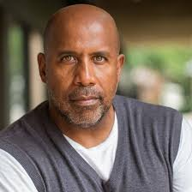
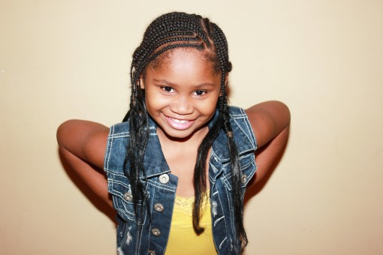
The Juarez-Jones family fight Covid-19 stress
Juanita makes a special dinner for her family and tells them all about lowering their stress with a resilience plan. She asks them what they think.
https://en.wikipedia.org/wiki/Castanets

Slide 30
Frank’s Plan
Frank says that he will question his negative thinking about not finding a job. He also plans on staying away from smoking and drinking by biking everyday. This will also give him a needed break from looking for a job. He asks Mary to join him on the bike trail. He plans to buy gum to help him quite the cigarettes.

Slide 31
Maria’s Plan
Maria admits to watching everything she can about Covid-19 on her I Pad in the middle of the night. She now sees that this is making her more afraid and making it harder for her to sleep. She will leave her I Pad in the living room at night. She will also put the thermometer back in the medicine cabinet. If she feels sick she will ask Juanita to feel her head before taking her temperature.
https://en.wikipedia.org/wiki/Castanets

Slide 32
Mary’s Plan
Mary really wants to have a game night. She wants to pick the games out and beat Daddy at checkers. She also wants to teach her Abuela how to play a video game. She says she thinks she should call her friends to talk. But, she tells her mom she is afraid for her to go back to work. How will she know her mom won’t get sick again?

Slide 33
Juanita’s Plan
Juanita tells Mary that she is also afraid to go back to work. She says she will face her fear by calling her boss to make sure they are all using masks and keeping social distancing. She also wants to make sure they will clean well. She will do everything she learned to keep herself safe while there. She has also decided that she will start to play her old accordion again. She knows that will keep her mind busy.

Slide 34
The family stress resilience action plan
Frank, Juanita, and Maria decide they will watch the local news every night and check the CDC website once a week. They will tell Mary when they learn something new.
Everybody will keep a gratitude journal and they will share what they wrote at their weekly game night.
They will remind each other to focus on what they can control
Frank made copies of the T-H-I-N-K questions so they can all question their thinking

Slide 35
The family stress resilience action plan
Each family member has picked something new to distract them from negative thoughts: Frank and Mary are exploring the bike trails near their house, Juanita is playing the accordion, and Maria has started a zoom bible study with her friends from church
Mary has made a poster that says “Be Kind to Yourself”
They all decide to take care of their health with regular sleep times, good food and exercise.
Juanita teaches everyone how to meditate.

Slide 36
Make your stress resilience action plan, include:
How you will change your “Information Diet”
Using a gratitude journal- what time a day will you do this?
Focusing on what you can control
Questioning your thinking
Distracting yourself from your thoughts
Being kind to yourself
Doing fun things with family and friends
Taking care of your health
Talking to people you trust

Slide 37
Lesson #5: The virus and our future
Lesson #5 is our last meeting about CoVid-19. What words do you want to know about and what questions do you want me to answer next week?
HEALTH LITERACY WORK GROUP

Slide 38
Stay Healthy!
Developed by:
Dr. Doris Ravotas
Fulbright Specialist
Master Faculty Specialist
School of Interdisciplinary Health Programs
College of Health and Human Services
KLC Fellow and Health Literacy Work Group Leader
Email: doris.ravotas@wmich.edu
HEALTH LITERACY WORK GROUP

Slide 39
References
CDC (2020). Daily Life Coping/Managing Stress . Retrieved on 4/20/20 from
https://www.cdc.gov/coronavirus/2019-ncov/daily-life-coping/managing-stress-
Good News Network (2020). Good News Today. Retrieved on 4/20/20 at https://www.goodnewsnetwork.org/
N.A. (2019). Older Latina(photograph). Retrieved on 4/20/20 from https://en.wikipedia.org/wiki/Castanets. CC
N.A. (2019). Concentration (image). Retrieved on 4/20/20 from http://www.design-4-
sustainability.com/feeds/newsfeed/2011/6?gp=10. CC BY-SA 3.0
N.A. (2020). Little girl with frowning face (image). Retrieved on 4/20/20 from
https://www.chiangraitimes.com/health/what-to-do-if-you-think-your-child-is-suffering-from-mental-illness
N.A. (2020). Fearful woman. (stress image). Retrieved on 4/20/20 from
http://teacherwritebookaholicohmy.blogspot.com/2012_07_01_archive.html. CC BY-NC-SA 3.0
N.A. (2020). Girl laying down. (image). Retrieved on 4/20/20 from N.A. (2020). Fearful woman. (image). Retrieved on 4/20/20 from
https://news.schoolsdo.org/2016/02/kids-who-go-to-bed-early-have-higher-gpas/
.
.

Slide 40
References (cont.)
N.A. anxiety (photo). (2020).Rertrieved on 4/22/20 from http://thecollaboratory.wikidot.com/general-psychology1-fa11. CC- SA 3.0
N.A. (2019). Stress (photo). Retrieved on 4/20/20 from http://pngimg.com/download/4751CC 4.0 BY-NC.
Rebecca (2014). Gratitude Heart (image). Retrieved on 4/20/20 from http://www.desertsojourn.com/thankful-in-all-times/
CC 4.0 BY-NC.
Wellness Society. (2020). Coronavirus Anxiety Workbook. Retrieved on 4/15/20 from https://thewellnesssociety.org/free-coronavirus-anxiety-workbook/

